Slide 1

Book Record Management Application. (Client-Sever Web Application)
SUBMITTED BY:-
Ravi Ranjan
BRANCH - CSE
ROLL NO- 16EEBCS073
SUBMITTED TO:-
Mr. Rishiraj Vyas
Department of Computer Science

Slide 2
Objective:-
A Book Record Management Client-Server Web Application where we can Perform Following Operations.
Insert Book
View All Book Present In Database
Update Book Record
Delete The Book Record
Tools To Be Used:-
IDE:- Eclipse to develop the project.
Front End:- HTML, CSS, Bootstrap
Middle End:- Servlet
Backend:- Oracle 10g express edition

Slide 3
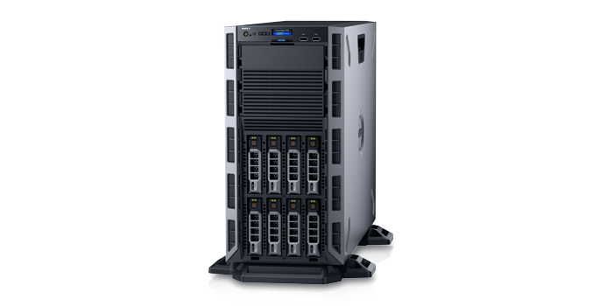

Client & Server:-
Request
Response
Client
Server
Client is a computer that connects to and uses the resources of a remote computer, or server. like files, information, songs , videos etc.
Client is also another name for a software used to connect to a server.
A client can also be another term used to describe a user.

Slide 4

Project Structure:-
insert.
html
Insert.java
insert.css
Server
Book
View.java
Client
Index.html
Update.java
index.css
Delete.java

Slide 5
Project Page Design

Slide 6
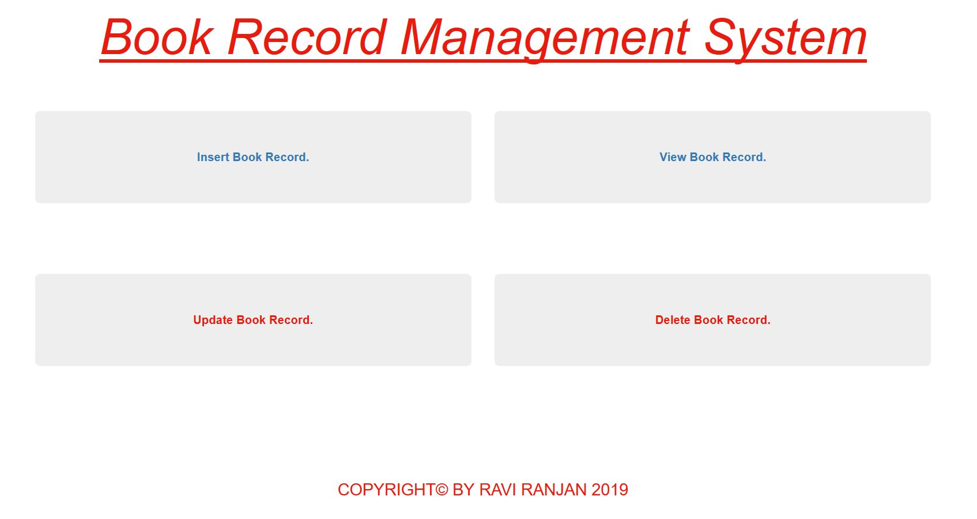
index.html

Slide 7
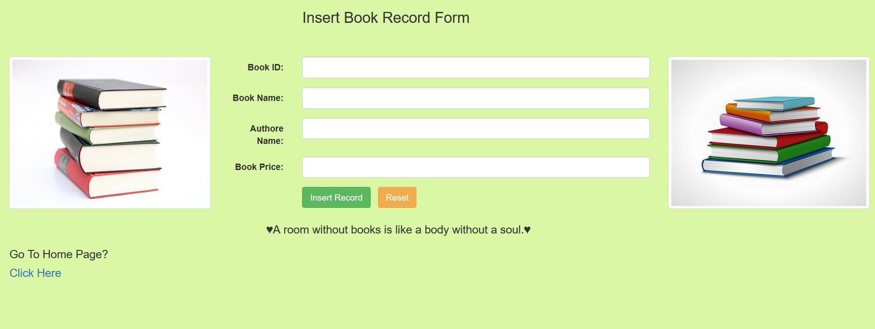
insert.html

Slide 8
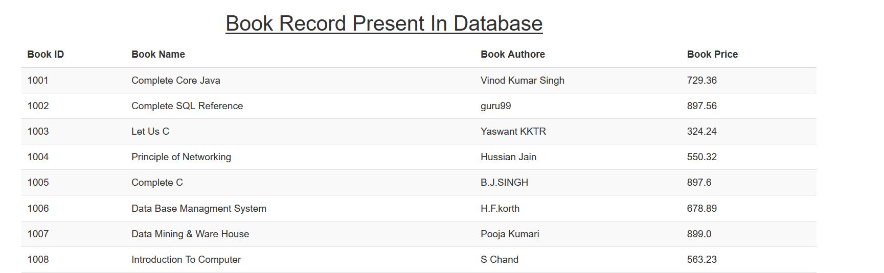
View.java

Slide 9
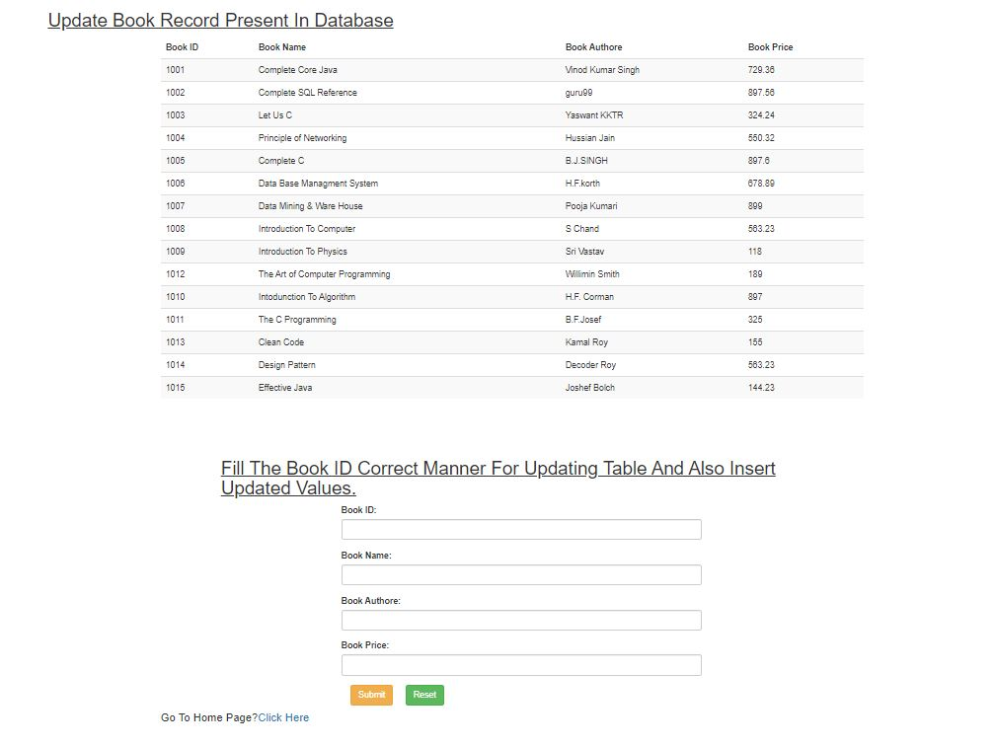
Update.java

Slide 10
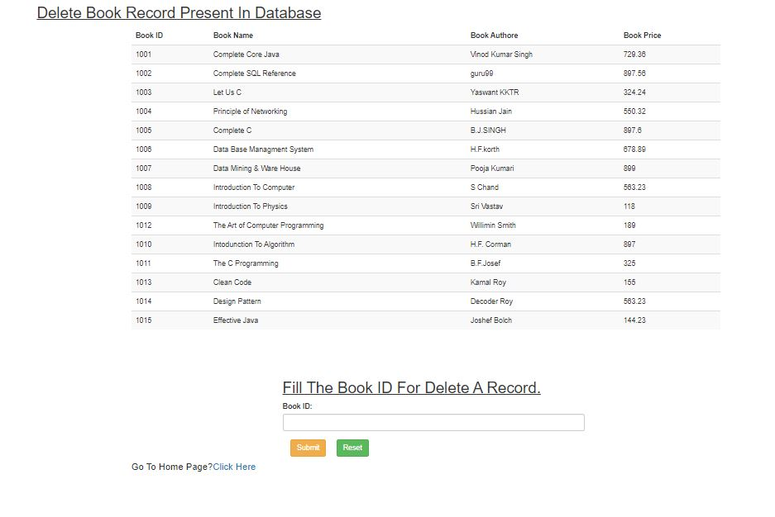
Delete.java

Slide 11
Project Working Flow

Slide 12
1. Insert Book Record

Slide 13
Server
Client
RAM
Server Software(Apache Tomcat)
Chrome Browser
Request
Web container
http://localhost:9090/BookRecordManagementApplication/
HDD
index.html
insert.html
Book Database
Response
View.java
Insert.java
Client enter the URL in browser.
insert.html page
Update.java
Delete.java

Slide 14
Server
Client
RAM
Server Software(Apache Tomcat)
Chrome Browser
Request
Web container
http://localhost:9090/BookRecordManagementApplication/insert.html
HDD
index.html
insert.html
Book Database
Response
View.java
Insert.java
Click on the “Insert Book Record”
Insert.java Page
Update.java
Delete.java

Slide 15
Server
Client
RAM
Server Software(Apache Tomcat)
Chrome Browser
Request
Web container
http://localhost:9090/BookRecordManagementApplication/insert.html
HDD
index.html
insert.html
1001
Book Database
The C Language
Response
Ravi Ranjan
324.56
View.java
Insert.java
Enter The Details &
Click On Submit Record
Update.java
Delete.java

Slide 16
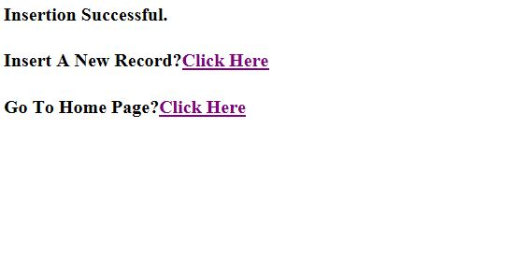
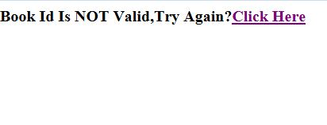
Server
Client
RAM
Server Software(Apache Tomcat)
Chrome Browser
Request
Web container
http://localhost:9090/BookRecordManagementApplication/Insert?bid=1016&bname=Java+Complete+Reference&aname=Oracle+Publication&bprice=789.00&submit=Insert+Record
HDD
index.html
insert.html
Book Database
Response for successful insertion
View.java
Insert.java
Response for failed
insertion
Result After Inserting Record.
Update.java
Delete.java

Slide 17
2. View Book Record

Slide 18
Server
Client
RAM
Server Software(Apache Tomcat)
Chrome Browser
Request
Web container
http://localhost:9090/BookRecordManagementApplication/
HDD
index.html
insert.html
Book Database
Response
View.java
Insert.java
Client enter the URL in browser.
insert.html Page
& Click On View Book Record
Update.java
Delete.java

Slide 19
Server
Client
RAM
Server Software(Apache Tomcat)
Chrome Browser
Request
Web container
http://localhost:9090/BookRecordManagementApplication/View
HDD
index.html
insert.html
Book Database
Response
View.java
Insert.java
View.java Page
Update.java
Delete.java

Slide 20
3. Update Book Record

Slide 21
Server
Client
RAM
Server Software(Apache Tomcat)
Chrome Browser
Request
Web container
http://localhost:9090/BookRecordManagementApplication/
HDD
index.html
insert.html
Book Database
Response
View.java
Insert.java
Client enter the URL in browser.
insert.html Page
& Click On Update Book Record
Update.java
Delete.java

Slide 22
Server
Client
RAM
Server Software(Apache Tomcat)
Chrome Browser
Request
Web container
http://localhost:9090/BookRecordManagementApplication/Update
HDD
index.html
insert.html
Book Database
View.java
Insert.java
Response
Update Record Page
Update.java Page
Update.java
Delete.java

Slide 23
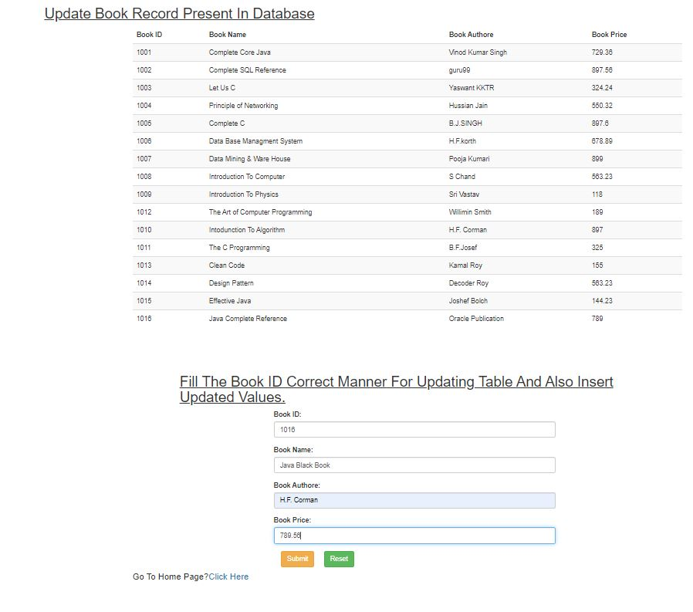
Server
Client
RAM
Server Software(Apache Tomcat)
Chrome Browser
Request
Web container
http://localhost:9090/BookRecordManagementApplication/Update
HDD
index.html
insert.html
Book Database
View.java
Insert.java
Response
Enter The Updated Details
& Click On submit
Update.java
Delete.java

Slide 24
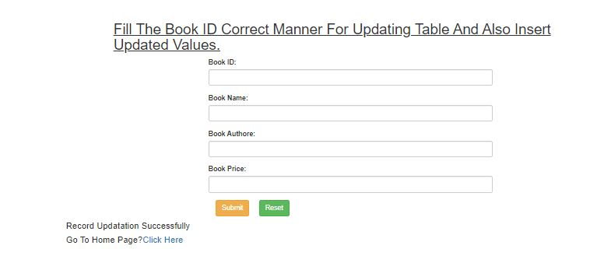
Server
Client
RAM
Server Software(Apache Tomcat)
Chrome Browser
Request
Web container
http://localhost:9090/BookRecordManagementApplication/Update
HDD
index.html
insert.html
Book Database
View.java
Insert.java
Response
If updating is successfully
Update.java
Delete.java

Slide 25
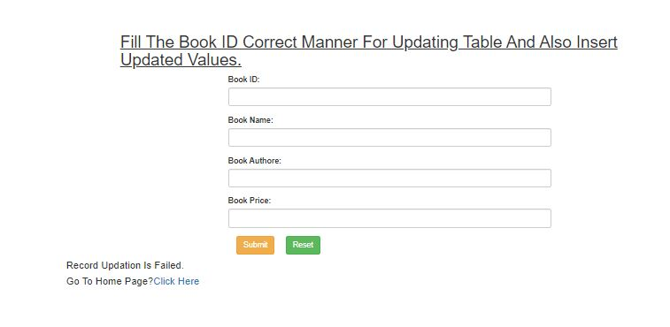
Server
Client
RAM
Server Software(Apache Tomcat)
Chrome Browser
Request
Web container
http://localhost:9090/BookRecordManagementApplication/Update
HDD
index.html
insert.html
Book Database
View.java
Insert.java
Response
If updating is failed
Update.java
Delete.java

Slide 26
4. Delete Book Record

Slide 27
Server
Client
RAM
Server Software(Apache Tomcat)
Chrome Browser
Request
Web container
http://localhost:9090/BookRecordManagementApplication/
HDD
index.html
insert.html
Book Database
Response
View.java
Insert.java
Client enter the URL in browser.
index.html Page
Click on Delete Book Record
Update.java
Delete.java

Slide 28
Server
Client
RAM
Server Software(Apache Tomcat)
Chrome Browser
Request
Web container
http://localhost:9090/BookRecordManagementApplication/Delete
HDD
index.html
insert.html
Book Database
View.java
Insert.java
Response
Delete.java Page
Update.java
Delete.java

Slide 29
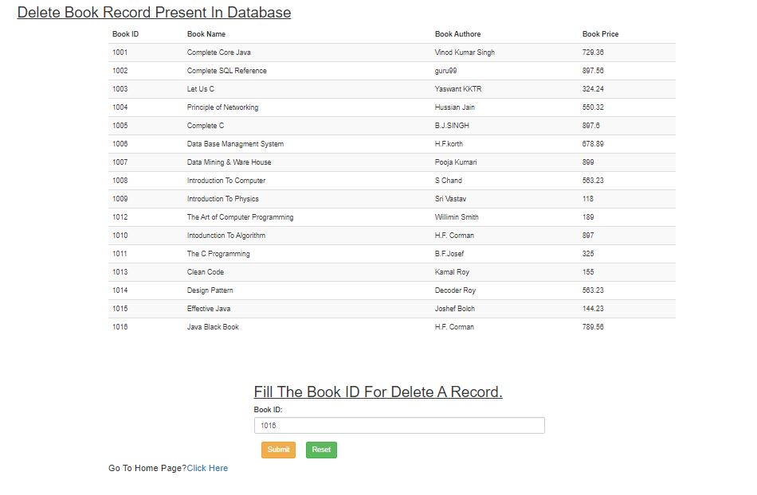
Server
Client
RAM
Server Software(Apache Tomcat)
Chrome Browser
Request
Web container
http://localhost:9090/BookRecordManagementApplication/Delete
HDD
index.html
insert.html
Book Database
View.java
Insert.java
Response
Enter the Book ID & click on submit
Update.java
Delete.java

Slide 30
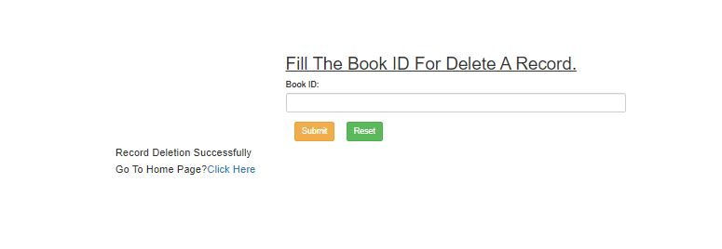
Server
Client
RAM
Server Software(Apache Tomcat)
Chrome Browser
Request
Web container
http://localhost:9090/BookRecordManagementApplication/Delete
HDD
index.html
insert.html
Book Database
View.java
Insert.java
Response
If Successful Deletion
Update.java
Delete.java

Slide 31
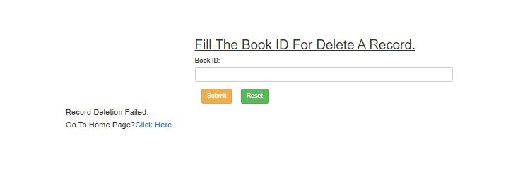
Server
Client
RAM
Server Software(Apache Tomcat)
Chrome Browser
Request
Web container
http://localhost:9090/BookRecordManagementApplication/Delete
HDD
index.html
insert.html
Book Database
View.java
Insert.java
Response
If Deletion Failed
Update.java
Delete.java

Slide 32
Thank You!

